Slide 1
Azure Brushup

Slide 2
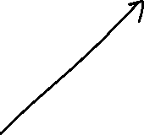









Slide 3
Azure AD
Identity and Access Management Service
User and Group Management
Licenses
App Registrations
Self Service Password Reset
SSO

Slide 4












User 1
User 2
User 3
User 4
User 5
Group 1
Group 2
Group 3
Group 4
Group 5
Subscription 1
RG 1
RG 2
RG 3
Subscription 2
RG 4
RG 5
Management Group
Subscription 1
RG 1
RG 2
Subscription 2
RG 4
RG 3
RG 5

Slide 5
Azure Virtual Machines
IaaS Cloud Services
Planning Checklist
Start with VNet
Name of the VM : Ex – devusc-webvm01
Decide the location of VM
Determine the size
Storage for the VM
Operating System

Slide 6
High Availability
Availability Sets – Rack Failure
Availability Zones – Data Center
Virtual Machine Scale Set – Auto Scaling

Slide 7
Storage
Scalable Object Store – Blob Storage
File system service for the cloud – File Share
Messaging Store – Queue Storage
NoSQL store – Tables
Types:
General Purpose v2
General Purpose v1
Blob Storage

Slide 8



Redundancy
LRS
ZRS
GRS
RA-GRS
GZRS
RA-GZRS

Slide 9
Virtual Network
Representation of your own network in the cloud
CIDR – Classless Interdomain Routing
Address Space – 10.0.0.0/16
Subnet: VNet segmented into one or more subnets
Service Endpoint – Extends virtual network to service

Slide 10
IP Addressing
Public IP
Private IP

Slide 11







Network Security Group
A service to limit the network traffic to resources in a virtual network
Inbound Rules
Outbound Rules

Slide 12
















Azure Load Balancer
High availability and network performance to your applications
OSI Layer 4

Slide 13
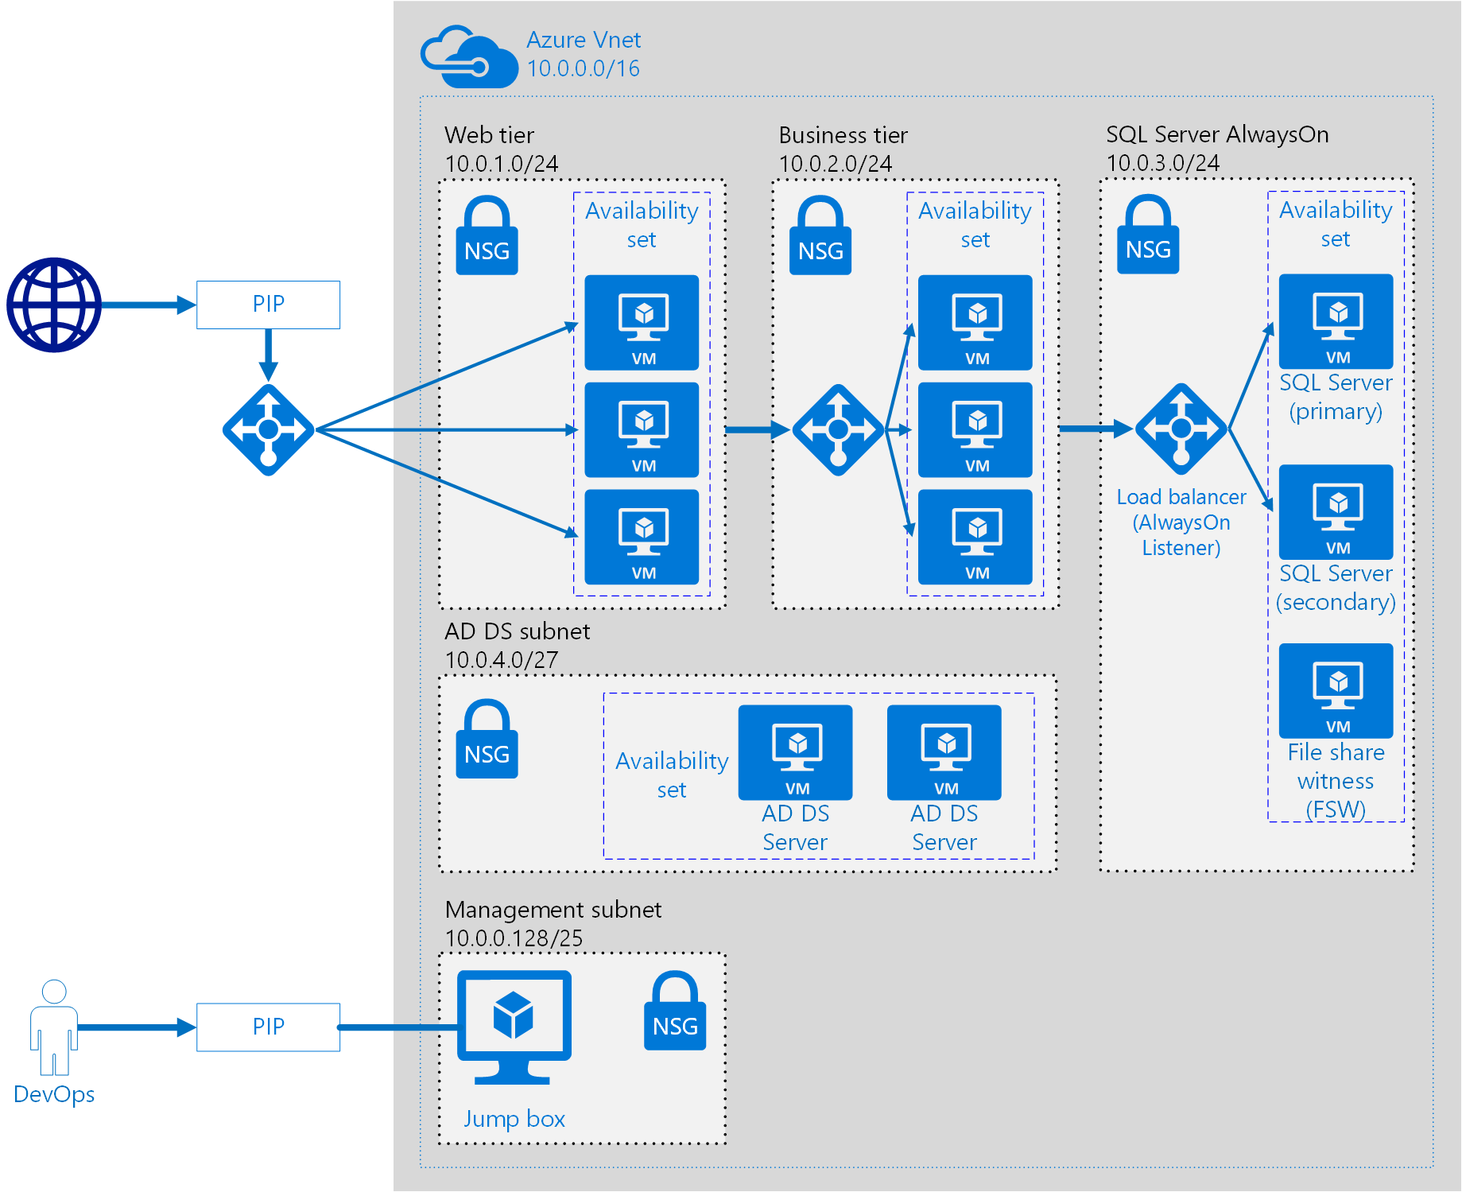

















Slide 14














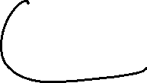


Slide 15
App Service
PaaS from Microsoft to deploy, design and scale web apps
App Service
App Service Plan

Slide 16

App Service
Container Instance
AKS

